Slide 1
Development and Automated Testing of RESTful APIs Lesson 04
Prof. Andrea Arcuri
Kristiania University College, Oslo, Norway

Slide 2
Goals
Get a basic understanding of Combinatorial Optimization
See how Evolutionary Algorithms (EA) work
This will be necessary to understand how EA can be used to generate test cases for REST APIs

Slide 3
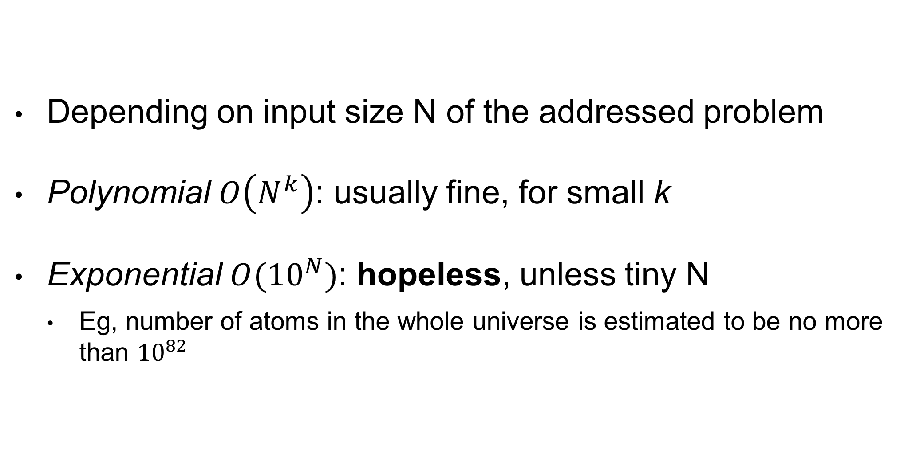
Runtime Of Algorithms
Depending on input size N of the addressed problem
Polynomial $O\left(N^{k}\right)$: usually fine, for small k
Exponential $O({10}^{N})$: hopeless, unless tiny N
Eg, number of atoms in the whole universe is estimated to be no more than ${10}^{82}$

Slide 4
Complex Problems
There are a lot of problems in science and engineering for which we do not know any algorithm that can solve them in polynomial time
Such algorithms might exist, but we do not know them yet
Brute Force: try all possible combinations, until find valid solution… but that is exponential!!!
We need some heuristics to address these problems
But no guarantee that we can find a solution in reasonable time

Slide 5
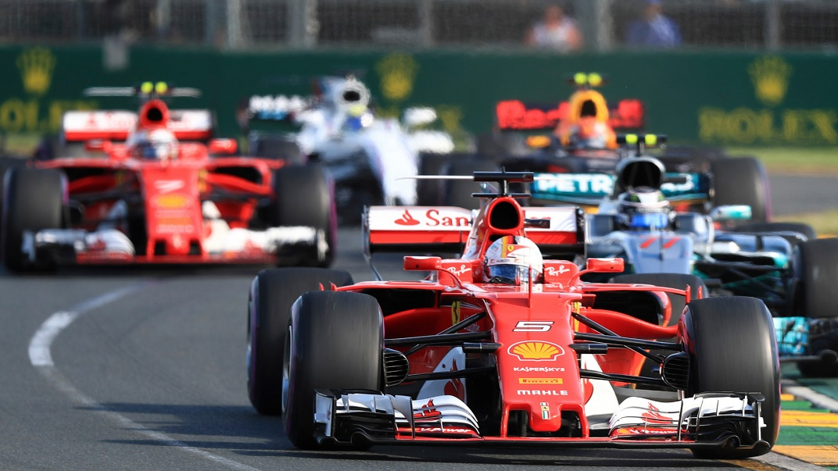
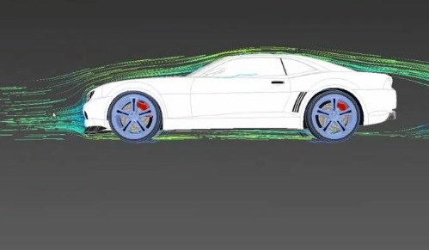

Vehicle Design
How to find best shape to reduce air resistance?
Can have different designs, and then test them in a wind tunnel

Slide 6
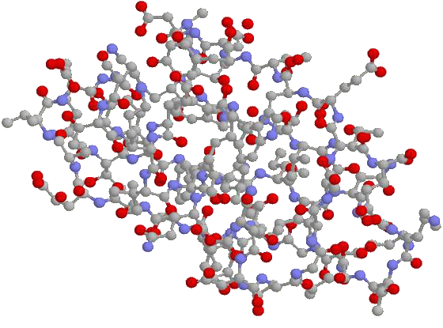
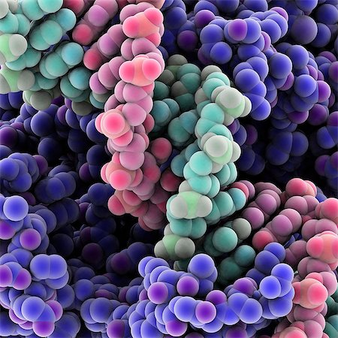
Protein Design
How to find the right sequence of amino acids which will result in a protein with some sought properties?

Slide 7


Stock Market
How to find best investment portfolio to maximize profit?

Slide 8


Class Schedule
How to find best class schedule for which:
There is time for all classes
Classes in same year are not in parallel (ie conflicting)
Preferences of lectures are taken into account
Etc.
?

Slide 9

RPG Equipment
In RPGs, how find best combination of wearable items to maximize attack and defense under the constraints of maximum weight and item slots available?

Slide 10
Optimization Problem
2 main components: Search Space and Fitness Function
Goal: find the best solution from the search space such that the fitness function is minimized/maximized

Slide 11
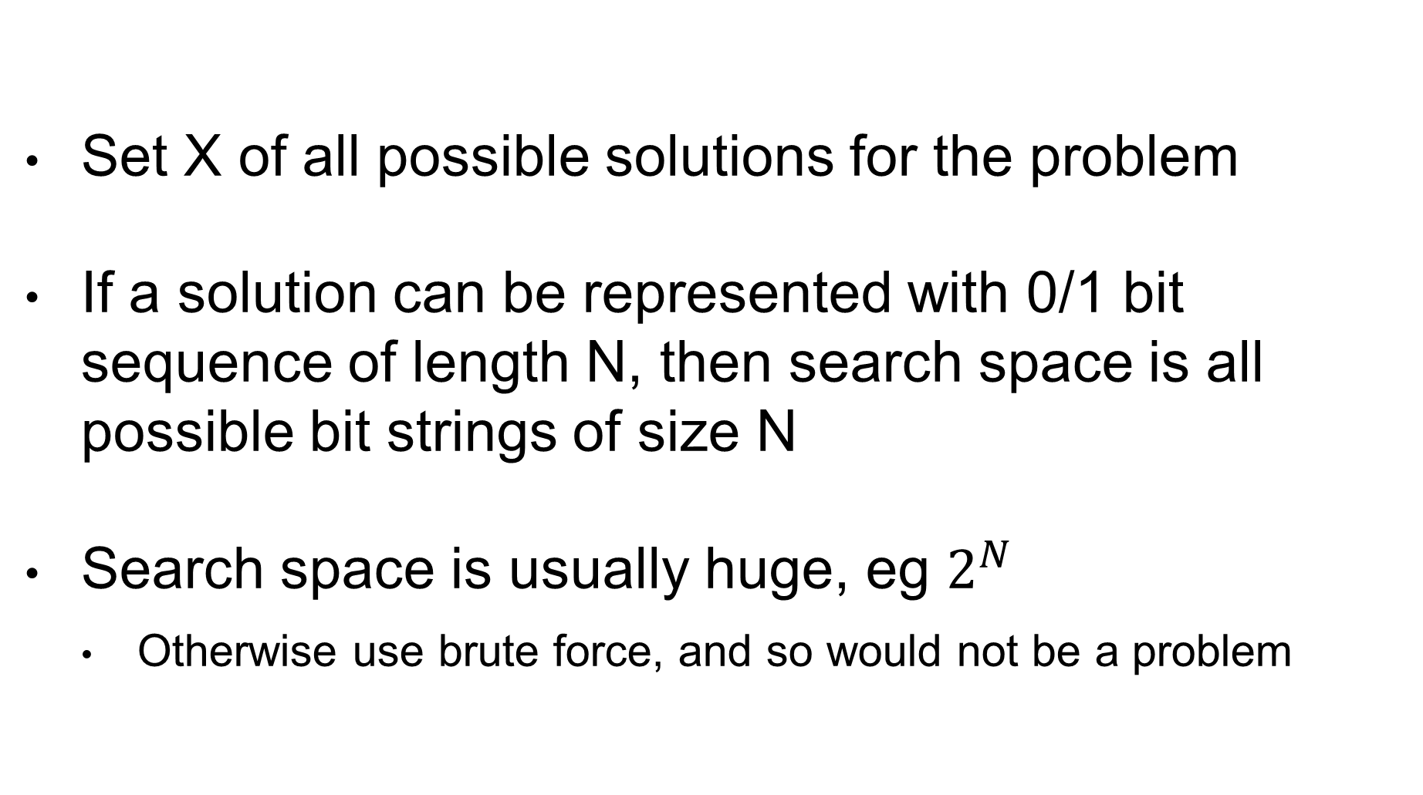
Search Space
Set X of all possible solutions for the problem
If a solution can be represented with 0/1 bit sequence of length N, then search space is all possible bit strings of size N
Search space is usually huge, eg $2^{N}$
Otherwise use brute force, and so would not be a problem

Slide 12
Fitness Function
f(x)=h
Given a solution x in X, calculate an heuristic h that specifies how good the solution is
Problem dependent, to minimize or maximize:
Minimize air resistance
Maximize protein structure properties
Maximize Return Of Investment
etc.

Slide 13
Optimization Algorithms
Algorithm that explores the search space X
Only a tiny sample of X can be evaluated
Use fitness f(x) to guide the exploration to fitter areas of the search space with better solutions
Stopping criterion: after evaluating K solutions (or K amount of time is passed), return best x among the evaluated solutions
Many different kinds of optimization algorithms…
But as a user, still need to provide the representation and f(x)

Slide 14
Search Operator
s(x) = x’
An operator that, from a solution x, gives a new one x’
Still need to evaluate its fitness, ie f(x’)
The optimization algorithm will use the search operators to choose which new x’ in X to evaluate
The search operator will depend on the problem representation
Example: flip a bit in a bit-sequence representation

Slide 15
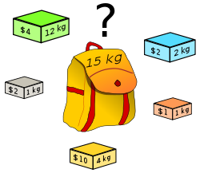
Example: Knapsack Problem (KP)
Insert N items to a knapsack
Each item has a weight w and a value v
The knapsack has a maximum load of weight L
Goal: find the selection of items that can be inserted within limit L, and for which the total value is maximized
Note: many real-world problems are instances of the knapsack problem

Slide 16
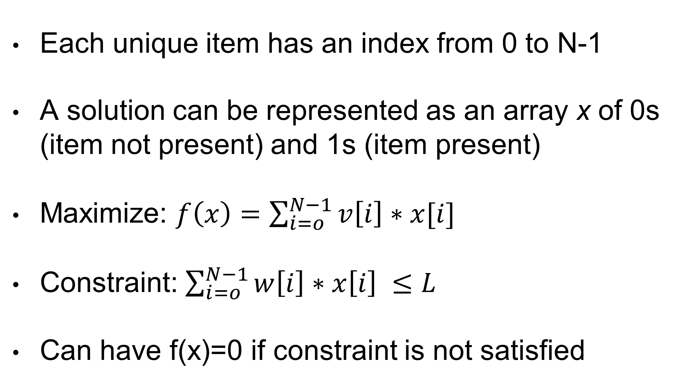
Details
Each unique item has an index from 0 to N-1
A solution can be represented as an array x of 0s (item not present) and 1s (item present)
Maximize: $f\left(x\right)=\sum_{i=o}^{N−1}{v\left[i\right]∗x[i]}$
Constraint: $\sum_{i=o}^{N−1}{w\left[i\right]∗x\left[i\right] ≤L}$
Can have f(x)=0 if constraint is not satisfied

Slide 17
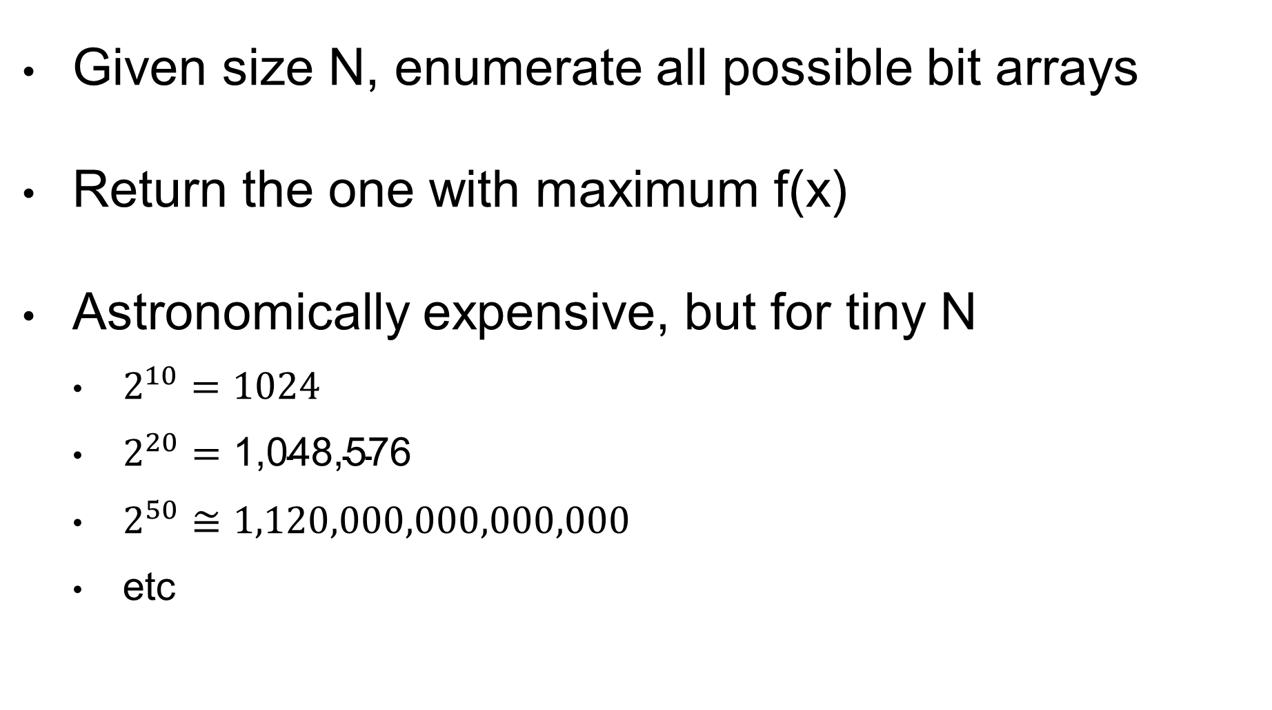
Brute Force
Given size N, enumerate all possible bit arrays
Return the one with maximum f(x)
Astronomically expensive, but for tiny N
$2^{10}=1024$
$2^{20}=\text{1,048,576}$
$2^{50}≅1,120,000,000,000,000$
etc

Slide 18
Greedy Algorithm
Build a solution as quickly as possible
Don’t explore the search space, but rather focus on the most promising path in it
Actual implementation is problem dependent
For example on KP:
Start from empty selection x
Add 1 item at a time to x (but how to choose???)
Stop when not possible to add any item

Slide 19
KP Example
L = 26
W = [12, 7, 11, 8, 9]
V = [24, 13, 23, 15, 16]
From https://people.sc.fsu.edu/~jburkardt/datasets/knapsack_01/knapsack_01.html

Slide 20
Greedy: Heaviest First
X | 1 | 0 | 1 | 0 | 0
W | 12 | 7 | 11 | 8 | 9
V | 24 | 13 | 23 | 15 | 16
First choose (12,24)
Then choose (11,13)
Weight becomes 12 + 11 = 23
Cannot add any other element without exceeding L=26
f(x) = 24 + 23 = 47
Is 47 the best score we can achieve???

Slide 21
Greedy: Lightest First
X | 0 | 1 | 0 | 1 | 1
W | 12 | 7 | 11 | 8 | 9
V | 24 | 13 | 23 | 15 | 16
Choosing (7,13), (8,15) and (9,16)
Weight becomes 7 + 8 + 9 = 24 < 26
Cannot add any other element without exceeding L=26
f(x) = 13 + 15 + 16 = 44
Worse solution 44 than previous 47

Slide 22
Greedy: Best Ratio
X | 1 | 0 | 1 | 0 | 0
W | 12 | 7 | 11 | 8 | 9
V | 24 | 13 | 23 | 15 | 16
Ratio | 2.00 | 1.85 | 2.09 | 1.87 | 1.77
Consider first the best ratio v/w, ie which item gives best return for unit of weight
Choose (11,23) and then (12,24)
Cannot add any other element without exceeding L=26
f(x) = 24 + 23 = 47
Different order of insertion, but still 47

Slide 23
Best Solution
X | 0 | 1 | 1 | 1 | 0
W | 12 | 7 | 11 | 8 | 9
V | 24 | 13 | 23 | 15 | 16
Weight is 7 + 11 + 8 = 26
f(x) = 13 + 23 + 15 = 51
Better than the previous 47
Greedy algorithms can be fast, but can give poor results
Need something more general, with better results

Slide 24
General Optimization Algorithms
Random Search (in this class)
Hill Climbing (in this class)
Simulated Annealing
Genetic Algorithms (next class)
Ant Colony Algorithms
Particle Swarm Algorithms
Etc. etc. (there are many)

Slide 25
Random Search (RS)
Easiest of the optimization algorithms
Sample a random solution from search space X
Keep sampling until run out of time
Keep track of best solution found so far

Slide 26

Hill Climbing (HC)
Start from a random solution
Keep track of / store one solution
Use search operator to do small modifications
If better solution, move to it, and repeat
If no better solution in the neighborhood, restart from a random solution

Slide 27
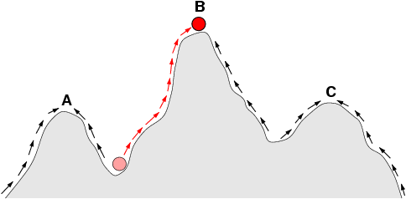
Very Simplified Example
Consider problem in which x is a number
Search operator is +- 1 on such x
“Climb” up to maximize f(x)
B is global optimum
A and C are local optima
Final result depends from starting point
f(x)
x
Fitness Landscape

Slide 28
HC for KP
HC is a general algorithm
But still need to define a proper search operator for each problem domain
Example:
add/remove 1 item (small neighborhood)
remove K items, add J different items (larger neighborhood)
The larger the neighborhood, the slower the ascent, so the less restart we can do within same time
Ie, it is not necessarily better

Slide 29
No Free Lunch (NFL) Theorem
What is the best optimization algorithm?
Which best variants / choice of parameters?
Considering all optimization problems, mathematically proved (NFL) that all optimization algorithms perform on average the same
Yes, it follows that, on some problems, RS is the best
There exist no best algorithm
But on specific problems, you can have some algorithms that are better than others, especially by exploiting domain knowledge
It follows that a general algorithm will perform worse than a specialized variant for a specific problem

Slide 30
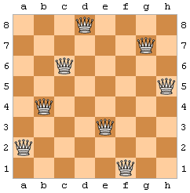
Queen Puzzle (QP)
Position 8 queens such that no 2 queens threaten each other
Generalization: N queens into a N*N board

Slide 31
QP As Optimization
Search Space: matrix N*N of bits
1 for a queen in that position, 0 otherwise
Search operator: flip bits in the matrix
Fitness: need to reward having N queens, and minimize number of threatened queens
00010000
00000010
00100000
00000001
01000000
00001000
10000000
00000100

Slide 32
QP: Better Representation
Binary matrix N*N would allow for any number of queens on the board (eg all 1s)
Domain knowledge: no 2 queens on same row, no 2 queens on the same column
Choose representation and search operator to only explore solution for which these constraints are satisfied
New representation: array of size N, with column indices from 0 to N-1 (position i is for queen in row i)
New operator: swap 2 column indices

Slide 33
QP Cont.
Representation: [f,a,e,b,h,c,g,d]
Eg, queen in row 1 is in column “f”, row 2 is in column “a”, etc
Search operator: swap two elements
Eg, swap “f” with “c”, [c,a,e,b,h,f,g,d]
By construction, I am only exploring board configurations that do not clash on columns/rows
But still a problem, as need to handle threating on diagonals

Slide 34
Decision Problem
Technically, QP is a decision problem
Once we find a solution with N queens no threating any other, we know we have found a global optimum
In optimization problems, usually we cannot know if we found the best
Decision Problem: can say “yes” or “no” about if a solution is optimal or not
For decision problems, still doing the same as optimization, only difference is that we can know when best solution is found
Practically all optimization problems have a decision variant for some metric K, eg “find knapsack configuration with total item values of at least K”

Slide 35
NP
NP: “Nondeterministic Polynomial time”
NP is “the set of all decision problems that can be solved in polynomial time on a theoretical non-deterministic Turing machine”
Equivalent, easier definition: “set of all decision problems whose solutions can be verified in polynomial time”
Ie, can answer “yes” or “no” in polynomial time
KP and QP are in NP:
QP: can quickly verify if N queens do not threaten each other
KP: can quickly verify in linear time if a solution has at least a certain value

Slide 36
P
P is the set of all decision problems that can be solved in polynomial time
P is at least a subset of NP… but is it a strict subset???
P = NP ???
P != NP ???
This is arguably the most important question in computer science for which we do not have an answer (yet)
Consequence: there might be undiscovered, efficient algorithms to solve today’s complex problems, or those might be impossible to design… we simply have no clue ☹

Slide 37
Nature Inspired Algorithms
Nature is good at solving many different problems
Idea: get inspiration from natural phenomena to create effective optimization algorithms
E.g., carbon-to-diamond process: high temperature in Earth's mantle, cooled slowly while raising up to surface
Simulated Annealing Algorithm
E.g., behavior of ants seeking a path between their colony and a source of food, based on pheromone trails
Ant Colony Optimization Algorithm

Slide 38
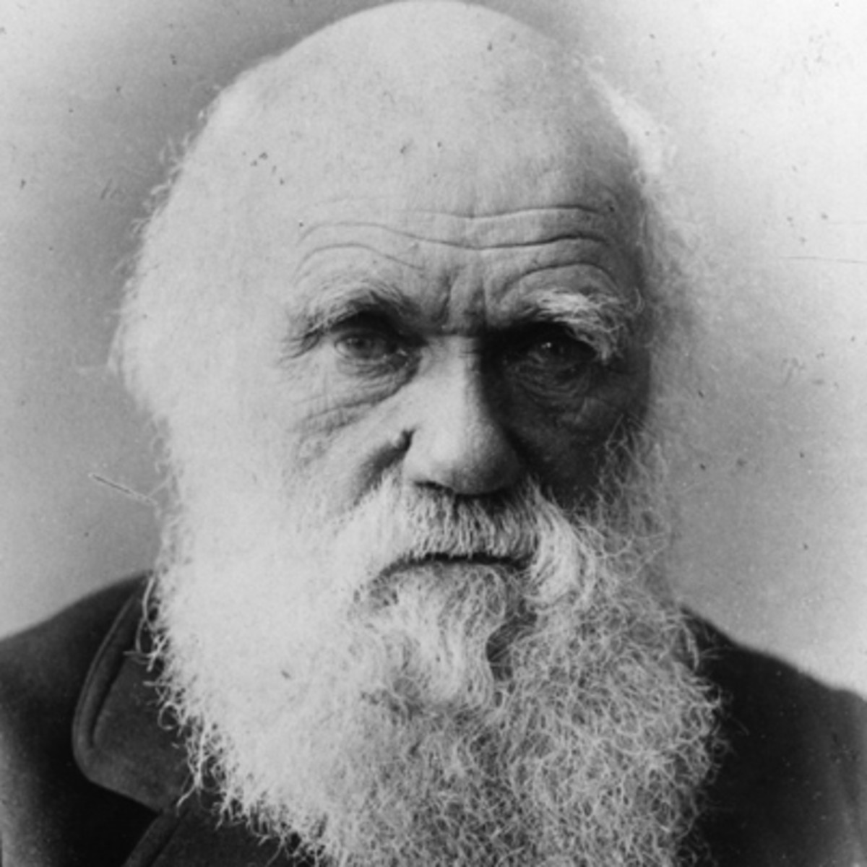
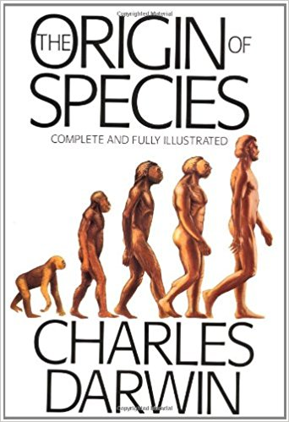
Theory Evolution
Charles Darwin, “The Origin of Species”, 1859
Theory describing how different species evolved from unicellular organisms

Slide 39
Evolutionary Algorithms (EAs)
EAs are optimization algorithms based on the theory of evolution
(1+1) EA: the simplest EA
Genetic Algorithms: the most popular EA
But there are more…

Slide 40
(1+1) EA
Mimic the evolution of a single individual that reproduces asexually, giving birth to only one offspring
Ie, 1 individual that produces 1 offspring
Evolution is driven by mutations in the chromosome of the offspring
Kill the offspring if worse than parent, otherwise kill parent after birth
Yep, evolution can be cruel…

Slide 41
Representation
The solutions in your problem space are the individuals you want to evolve
Eg queen positions on board
Chromosome: the actual representation of the individual
Eg, binary array 0/1 for knapsack problem
Mutation: similar to neighborhood in Hill Climbing, it samples new similar individuals

Slide 42
Mutation in 0/1 Sequence
1 | 1 | 0 | 0 | 0 | 1 | 0 | 1 | 0 | 0
Mutation: given N bits, each bit can be flipped with probability 1/N
Eg 10% probability in the above example
On average, only 1 bit is flipped per mutation operation
Non-zero probability to jump to any solution in the search space with a single mutation operator
ie, all bits can be flipped, although with low probability (1/N)^N
Reason: small modifications on average, but allow larger jumps to escape from local optima

Slide 43
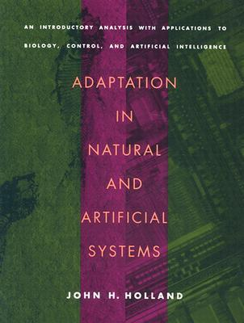
Genetic Algorithms (GAs)
1950s: Turing proposed use of evolution in computer programs
1970s: John Holland created GAs to address optimization problems
Simulate evolution of an entire population of individuals, which procreate sexually

Slide 44

Population
Keep track of K individuals
Eg, stored in an array
At the end of search, return the best solution in the population

Slide 45

Generation
The search will be composed of 1 or more generations
At each generation, select individuals for reproduction
Create a new generation of same size K
Kill the previous generation
Yes, evolution is really cruel…
Note: given same amount of fitness evaluations Z or time budget, a larger population K means less generations G, ie Z = K * G

Slide 46
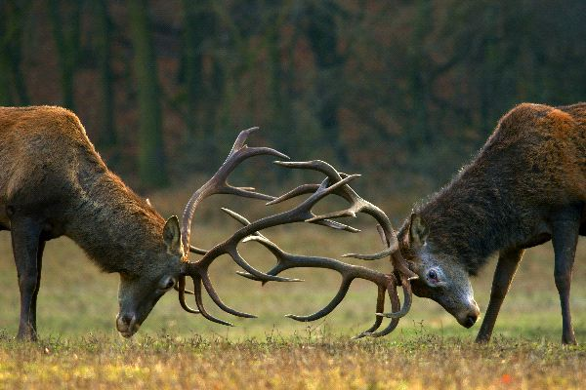
Selection
The fittest individuals will have higher chances of reproduction
Different strategies for parent selection
Tournament Selection: sample T individuals randomly from the population, and choose the best among them (according to the fitness function)

Slide 47

Sexual Reproduction
Select 2 parents, which give birth to 2 offspring
Note, ignoring gender here…
Offspring will share genetic material with their parents, via the crossover operation (aka xover)
After xover, offspring still have chances of getting mutated

Slide 48
Crossover
Parent 1
1 | 1 | 0 | 0 | 0 | 1 | 0 | 1 | 0 | 0
Parent 2
0 | 1 | 0 | 1 | 0 | 1 | 0 | 0 | 0 | 1
Choose a splitting point, eg the middle of the chromosomes
Offspring 1
1 | 1 | 0 | 0 | 0 | 1 | 0 | 0 | 0 | 1
Offspring 2
0 | 1 | 0 | 1 | 0 | 1 | 0 | 1 | 0 | 0

Slide 49
Xover Issues
In some domains, there are constraints in the representation
Eg, recall example of queen positions
A xover could lead to invalid offspring
Two options:
Kill them
Try to repair them

Slide 50
Elitism
You do not want to lose your best individuals
Unlucky in (tournament) selection
Negative mutations
At each generation, copy the best B individuals over the next generation, without xover or mutation
Even in evolution, some elite individuals still cheat the system and get preferential treatment…

Slide 51
Does this “crazy” stuff actually work???

Slide 52
Usage
Genetic Algorithms are among the most used kind of optimization algorithms
Successfully used in a lot, a lot of different domains
Goldberg’s 1989 book on GAs is among the most cited books in the whole field of Computer Science

Slide 53
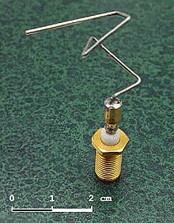
Example
Evolution of antenna designs
Optimize beamwidth and impedance bandwidth
Best found with an Evolutionary Algorithm
Used for example in NASA spacecrafts

Slide 54
More…
There is of course much more… we just scratched the surface
Tradeoff exploration vs exploitation of search landscape
Landscape Analysis
Parameter tuning
Multi-Objective Optimization of conflicting goals
Genotype vs Phenotype
Population diversity
Etc. etc.

Slide 55
Which Algorithm to Use?
Due to NFL, it depends on the problem
(1+1)EA is an easy to write algorithm, which gives good performance on many different kinds of real-world problems
For test case generation, we will see more specialized algorithms

